Slide 1
Data Cleaning and Viz
For “Mental Health in Tech” Data

Slide 2
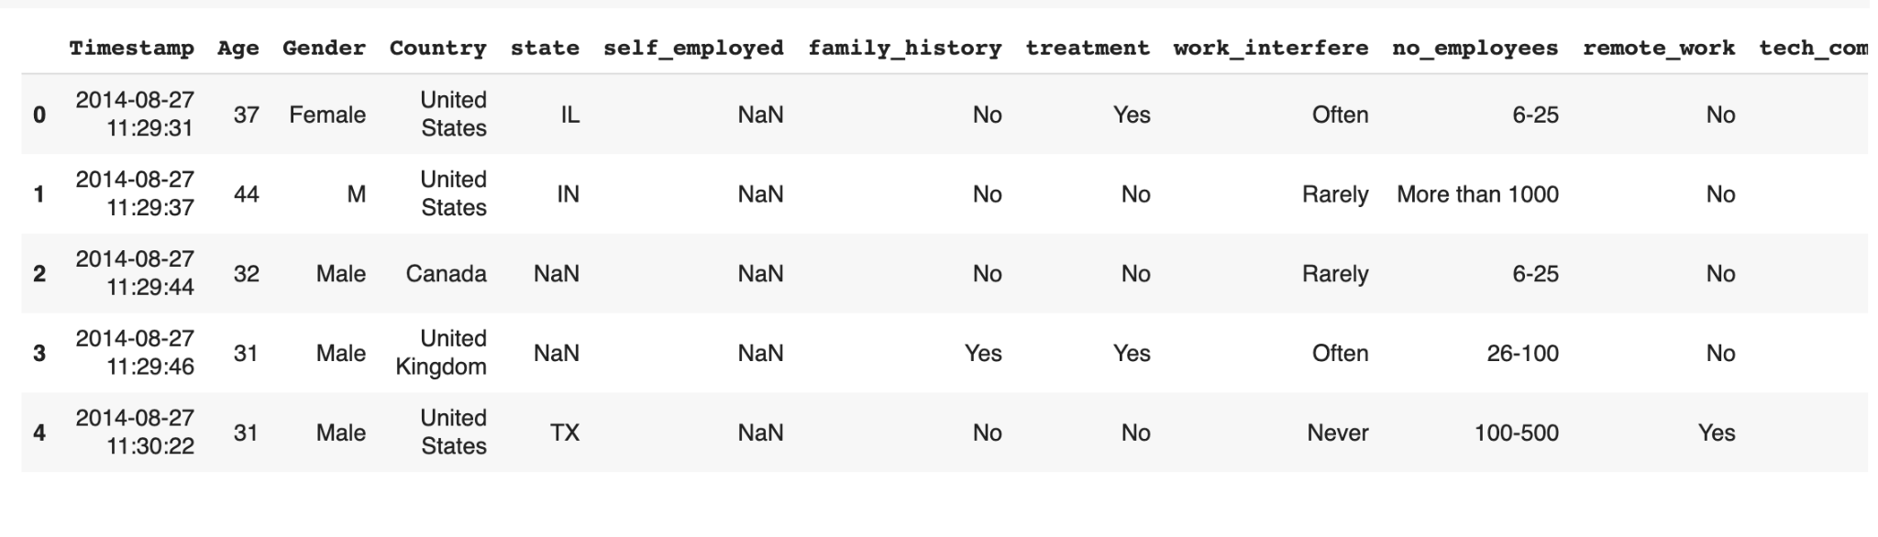
The dataset: Mental Health in Tech

Slide 3
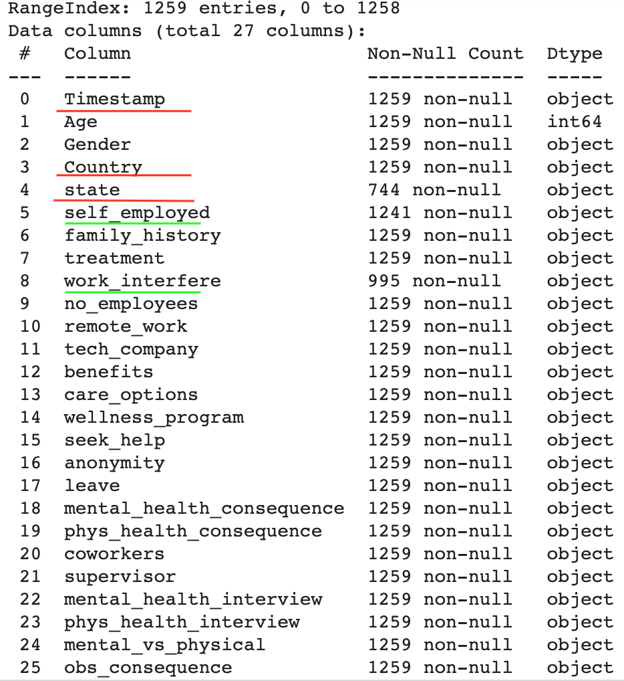
Columns in the dataset:

Slide 4
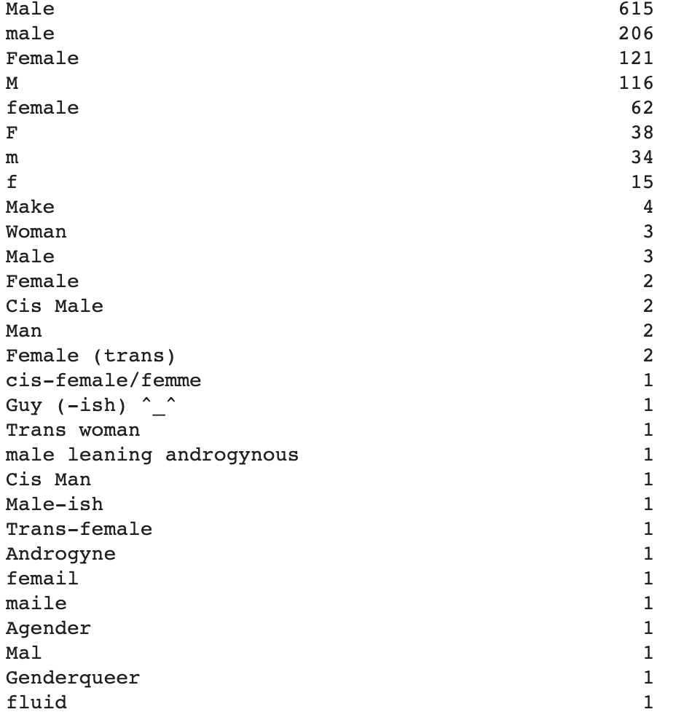
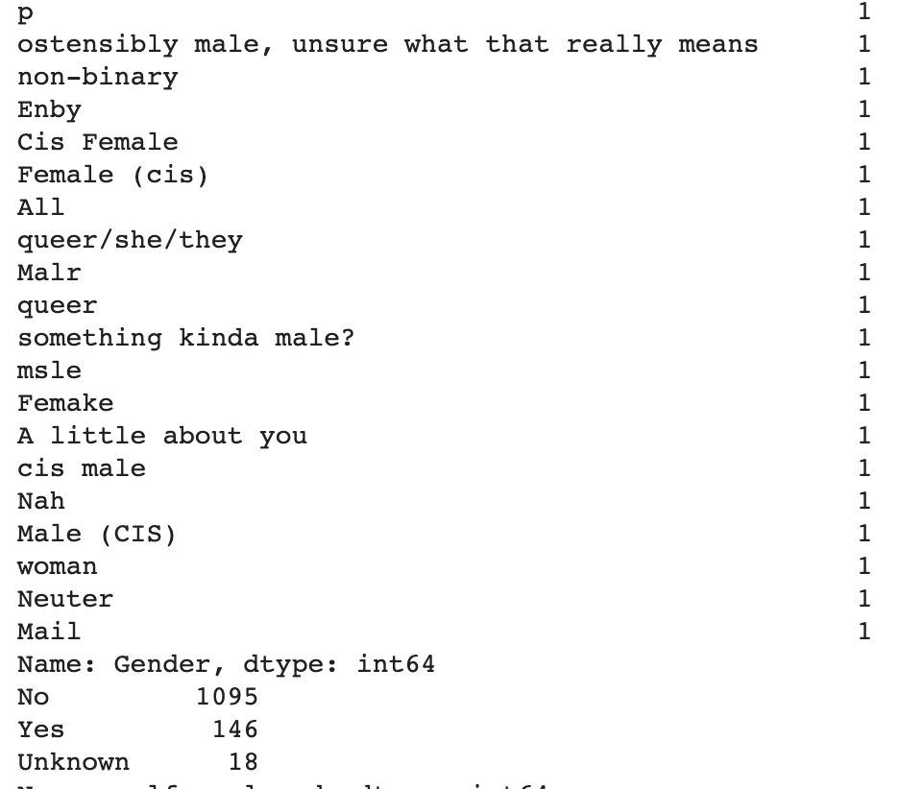
Correction of Categorical Inconsistencies in ‘Gender’

Slide 5
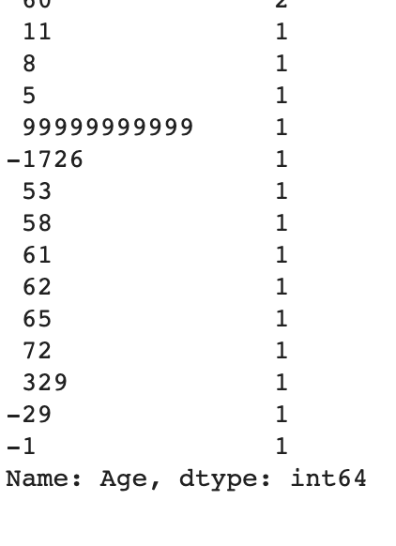
Dealing with impossible and unlikely inputs for ‘Age’:

Slide 6
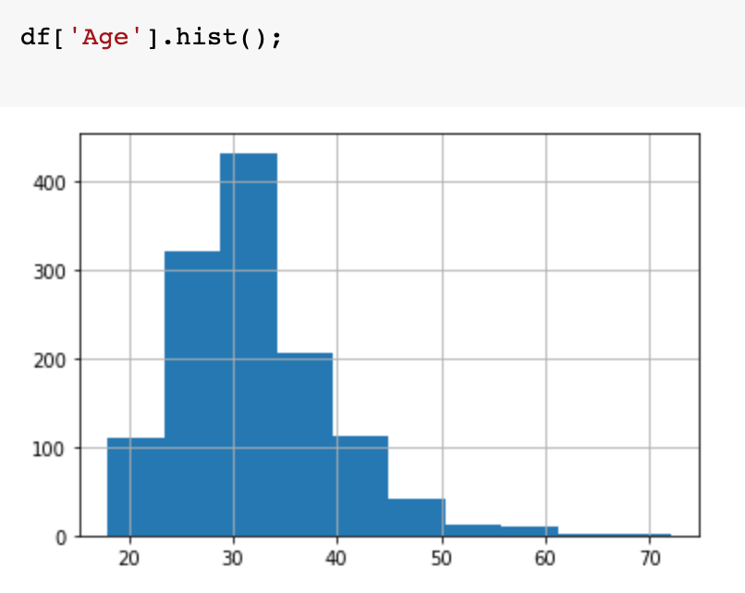
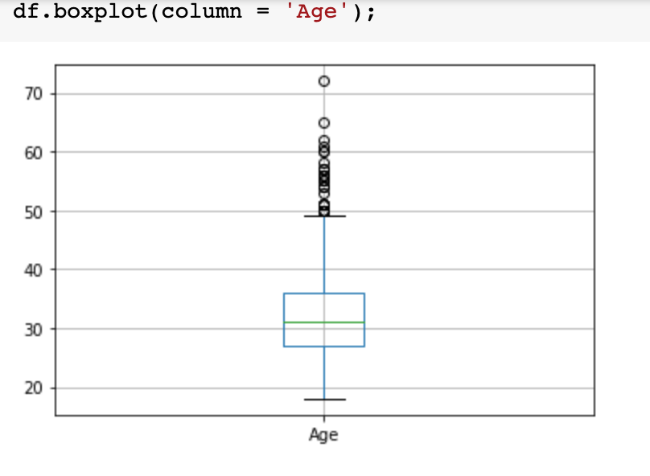
Univariate Visualization: ‘Age’

Slide 7
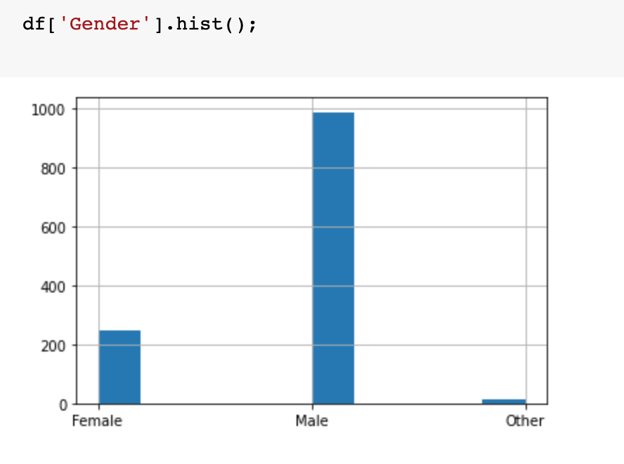
Univariate Visualization: ‘Gender’

Slide 8
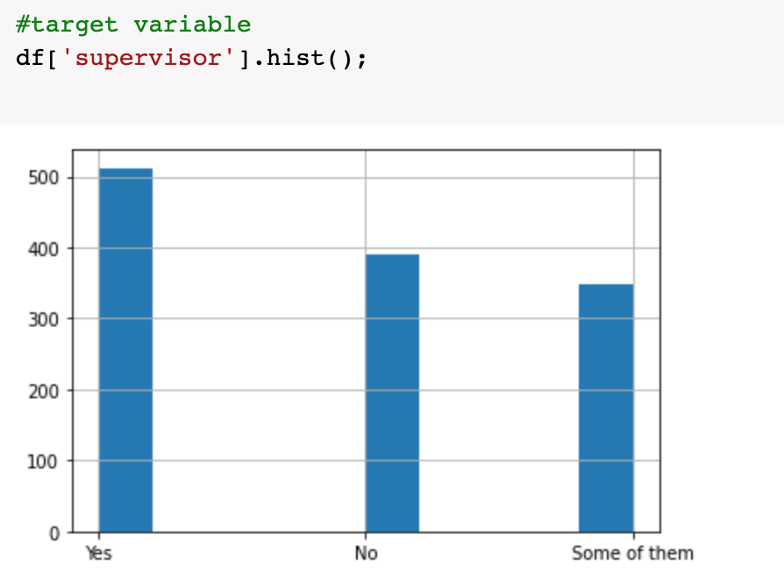
Univariate Visualization: ‘Supervisor’
(Whether or not they would be comfortable talking to their supervisor about mental illness)

Slide 9
Handling Unique Challenges:
-Categorical inconsistencies in ‘Gender’
-Handling bad data in ‘Age’

